Slide 1

Student Intervention, Monitoring and Support
Carmen Gordon
Undergraduate Orthodontic department
2022

Slide 2
5-Step Process
Initial Assessment
Gap Analysis
Learning & Teaching
Continuous
Assessments
Track Impact

Slide 3
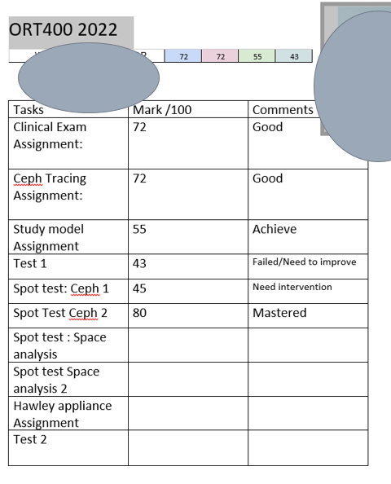
Step 1: Initial Assessment
Benchmark data used
Formative Assessments (Spot tests/ peer marking codes/<60%..redo)
Continuous Assessments
Used as attendance
Students invited
Google spreadsheet shared with them
Students needs analysis done: Google survey
Planning process: Dates, content etc
Track Impact

Slide 4
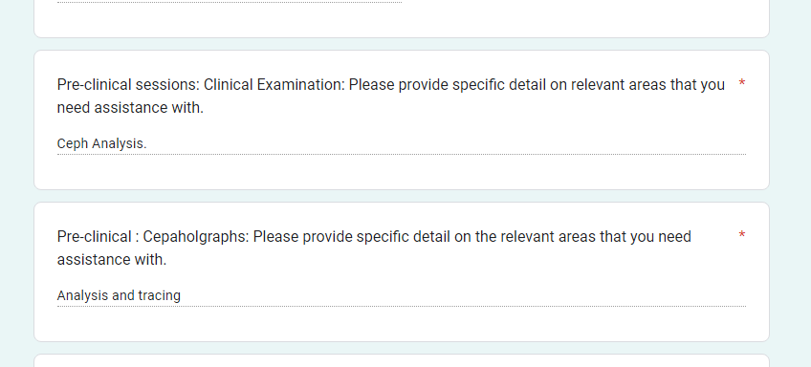
Data collection: Student Google form

Slide 5
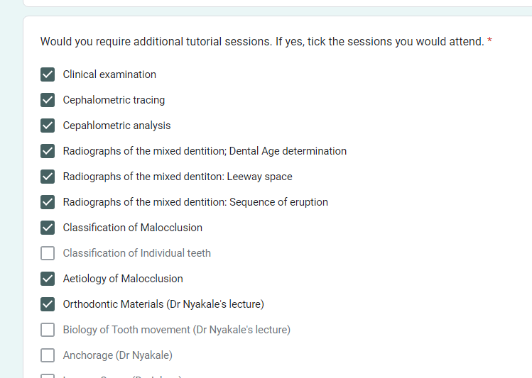
Checklist: data collection

Slide 6
Step 2: Gap Analysis
Diagnostic test:
To assess gaps in content knowledge.
Helps to define a structured intervention plan.

Slide 7
Step 3: Learning & Teaching
Participation:
Learner and instructor interaction: F2F contact sessions (In office)
Written communication, via email
Instant communication via Whats App
Guided learning at learner’s own pace

Slide 8
Step 3: Learning & Teaching…con
Content : Learners engage, investigated and discuss findings within groups (f or 30min). Self/Peer-learning.
Instructor facilitates and probes learners to guide them during discussions.
Discussion: Learners engage with instructors for an in depth discussion.
Activity: Tasks are completed at the end of the session.
Feedback: immediate feedback is provided.
Acknowledgement: Intervention participation forms are completed and signed

Slide 9
Step 4: Formative Assessment
Learners will be assessed continuously.
Assess on content learned
Spot test, quizzes, completing flow diaframs
Assignments
Mind maps
Take-home tasks

Slide 10
Step 5: Evaluation
Track Impact
Learner performance is analysed
Has learning outcomes been achieved / not.
Has the learner achieved the stipulated set academic and personal goals or not.
Learner progress is recorded (insignificant / significant/ mastered).
Mod. coordinator identifies the skills gap.
What challenges need to be addressed.
Identify obstacles that prevented the learner from achieving goals.

Slide 11
Step 5: Evaluation
Monitor improvements
Should learners retake tests to improve on specific areas
Complete summaries / progress reports.
Both learner and instructor sign the evaluation to indicate agreement.
If learner still not meeting the required academic goals after the intensive programme, a further formal remediation or learning support should be requested.
Learners are allowed to exit the programme once all targeted learning outcomes are achieved.
The module co-ordinator should keep all records and data for further reference.

Slide 12
3 levels of Intervention
Level 1: Initial Core intervention
Level 2: Supplemental Intervention: Intervention tailored and trimmed to improve on learning content misunderstood or goals not achieved at level 1.
Level 3: Intense intervention: Learners still not achieving significant progress will continue with level 3 intervention.

Slide 13
Reporting of students performance
Once students’ assessment data are collected , interpreted and recorded, student progress need to be reported to year co-ordinators to note at student affairs meetings (DENSA).This should be discrete in accordance with confidentiality requirements.
Reporting should be in writing.
Reporting is an ongoing process.
Regular feedback is provided to students as well. This does not imply it will contribute to learning.

Slide 14
Reporting of students performance
Constructive feedback given, should guide students on what focus areas need improving, or whether it has been achieved.
Strength’s and weaknesses in performance is highlighted in the feedback reports.
Feedback should also focus on what steps they should take in order to better attain the relevant learning outcome.
Instructors need to be culturally sensitive with feedback reports.
Feedback should be a dialogue: Students have the freedom to raise any concerns about the instructor’s guidance and support.
Continually encourage and reinforce completed learning outcomes attained.

Slide 15
Data Collection Instruments
Anecdotal records (written account of behavior, emotional facets of student)
Charts
Checklists
Assessment criterion
Worksheets
Evaluation
Exit tickets (mastered the learning outcome)
Tracking template

Slide 16
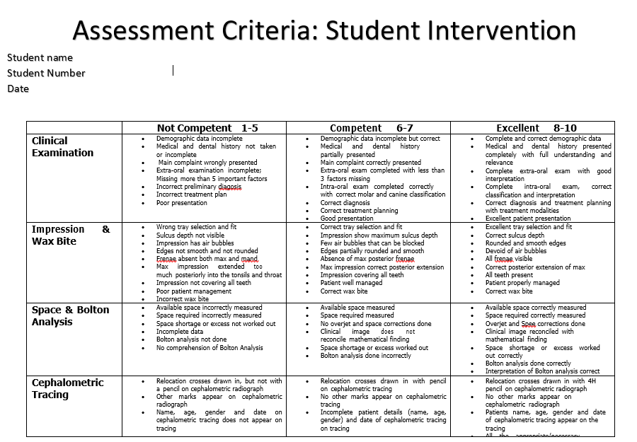

Slide 17
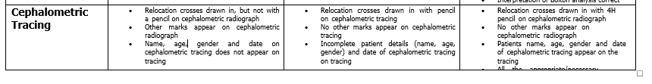
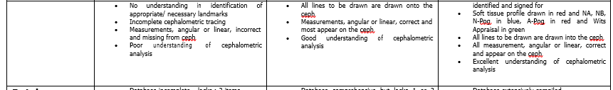

Slide 18
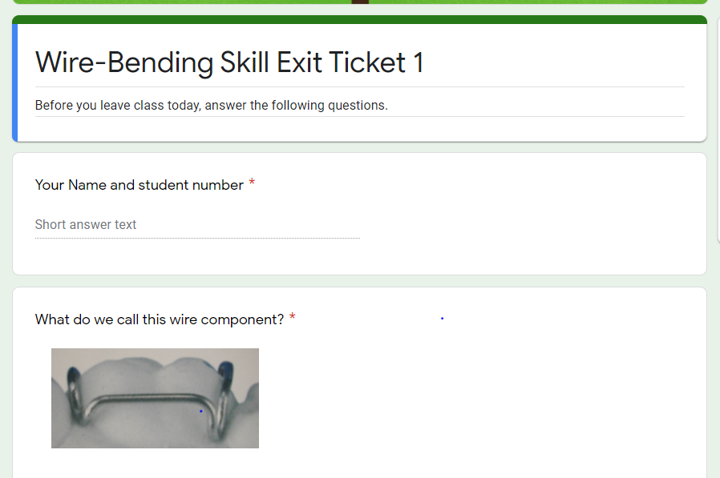

Slide 19
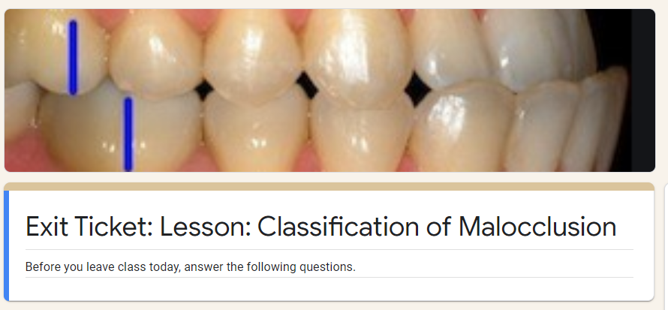

Slide 20
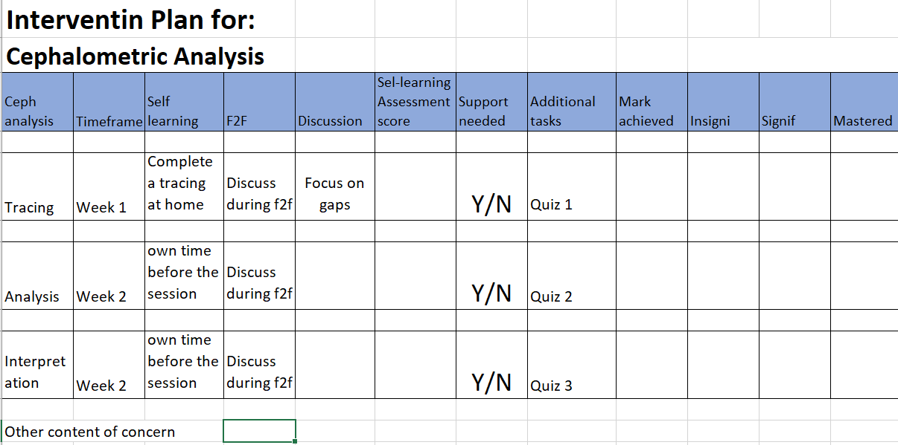

Slide 21
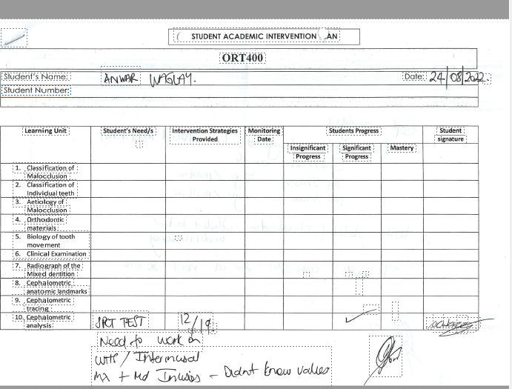

Slide 22
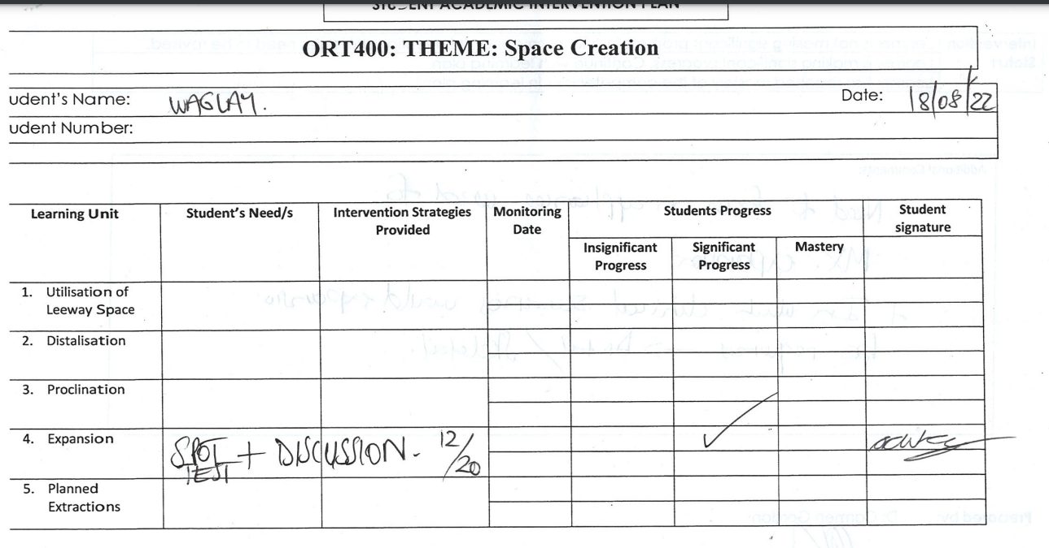

Slide 23
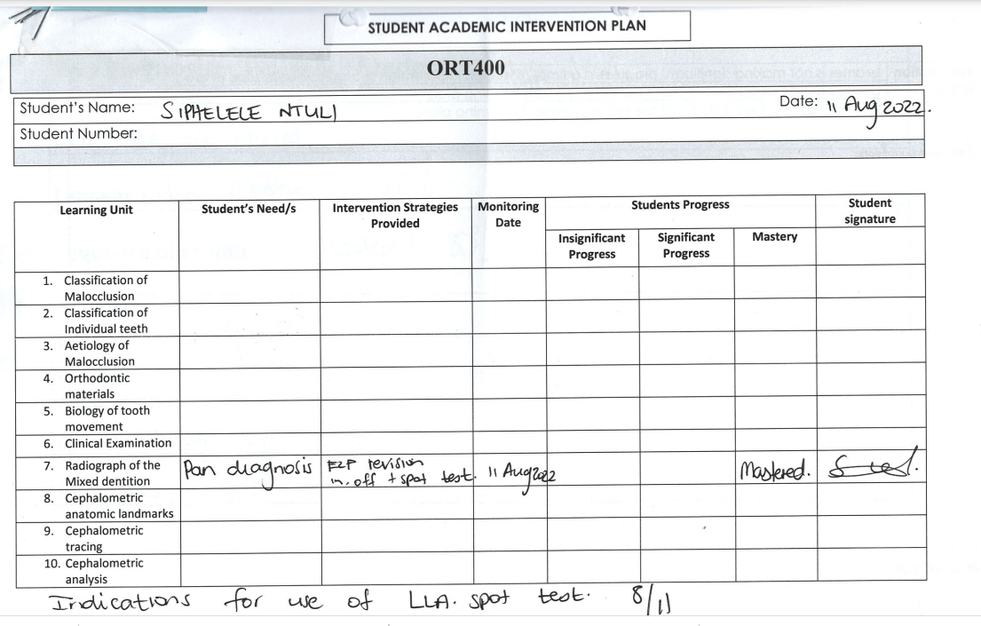

Slide 24
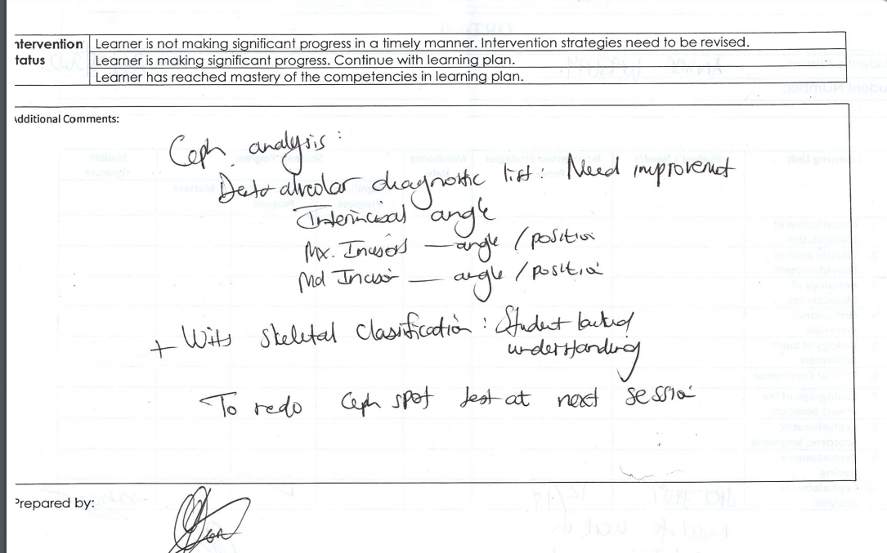
Summary Report

Slide 25
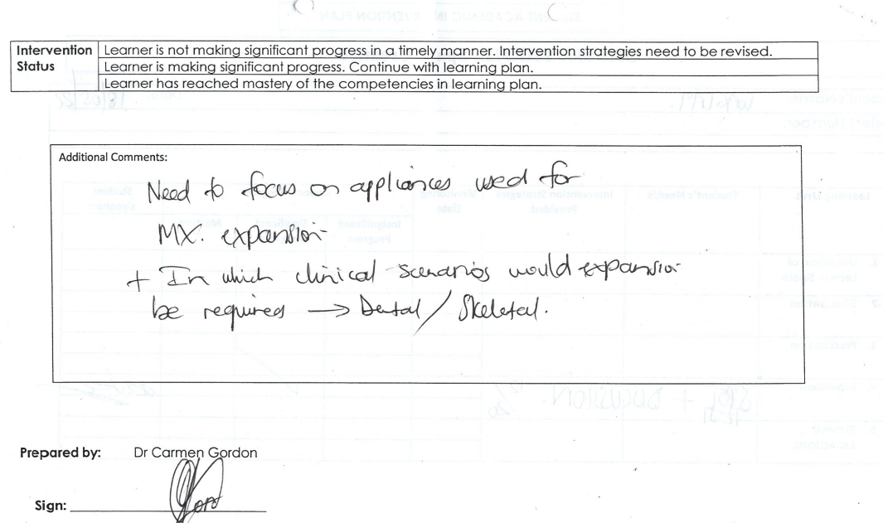

Slide 26
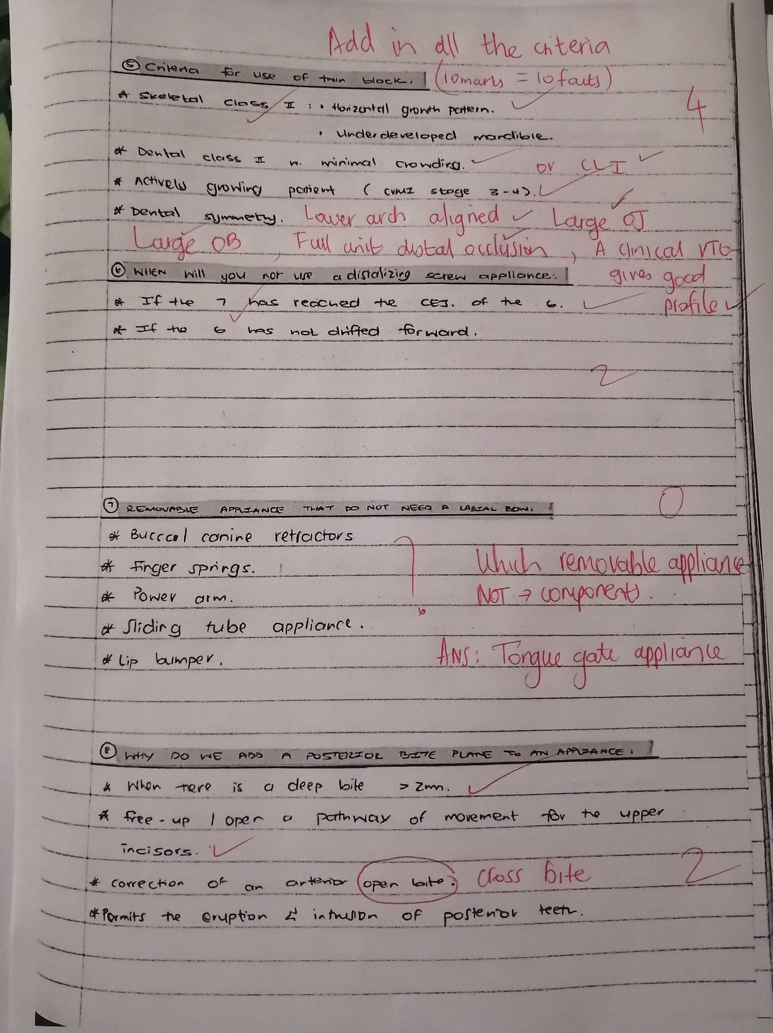
Formative assessment

Slide 27
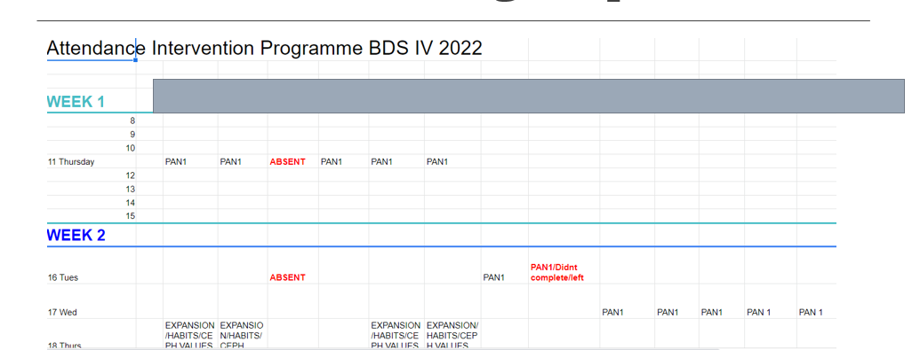
Attendance on Google Spreadsheet

Slide 28
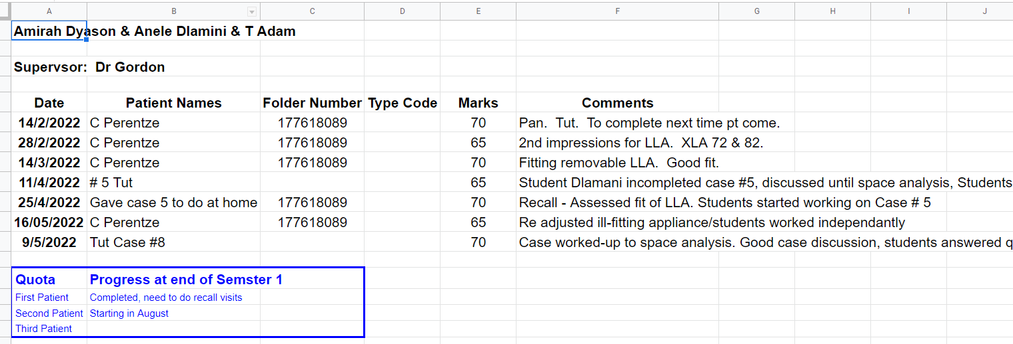
ORT511clinical tracking
Clinical Tracking sheets

Slide 29
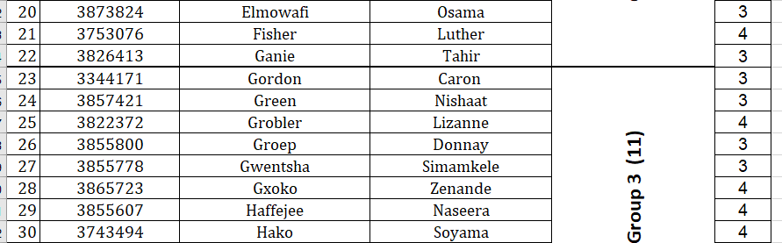
ORT511: Log books: At end of Term3
Quota assessed

